Slide 1
Homogeneity In Ejecta Velocity Of Type Ia Supernovae
Toby Heller

Slide 2
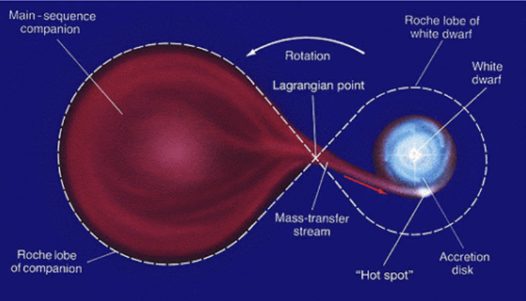

What is a Type Ia Supernova?
Subset of supernovae caused by the accumulation of matter by a white dwarf in a binary system
When the white dwarf exceeds the Chandrasekhar limit (${\sim 1.44M}_{⊙}$), it triggers a fusion reaction
$M_{v}≈−19.3$
Credit: Linda Hall Library

Slide 3
Research Questions
What shape does the distribution of ejecta velocities take (e.g. gaussian, bimodal, etc.)?
To what extent are the velocities uniform?

Slide 4
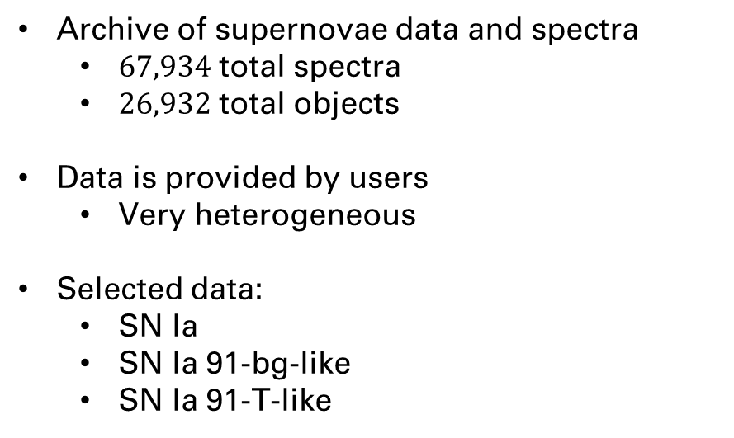
Data: WISeREP
Weizmann Interactive Supernova Data Repository
Archive of supernovae data and spectra
$67,934$ total spectra
$26,932$ total objects
Data is provided by users
Very heterogeneous
Selected data:
SN Ia
SN Ia 91-bg-like
SN Ia 91-T-like

Slide 5
Plan
Select data
Calculate metadata
Filter data using metadata
Preprocess
Filter out bad data (if necessary)
Fit gaussian around KDE/histogram

Slide 6
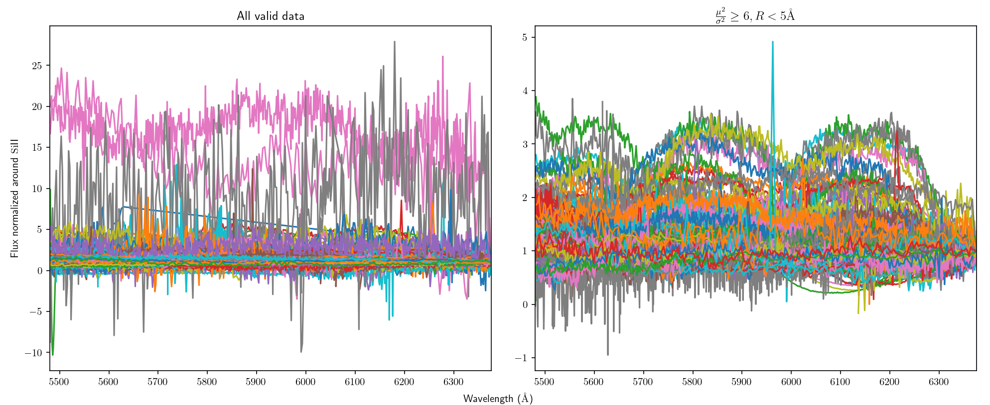


Metadata Filtering
Signal to Noise
$\frac{μ^{2}}{σ^{2}}≥6$
Mean Spectral Resolution
$R<5Å$

Slide 7
Preprocessing
Redshift normalization
Since I am looking at ejecta velocity, I need to change my data to be in the reference frame of the object

Slide 8
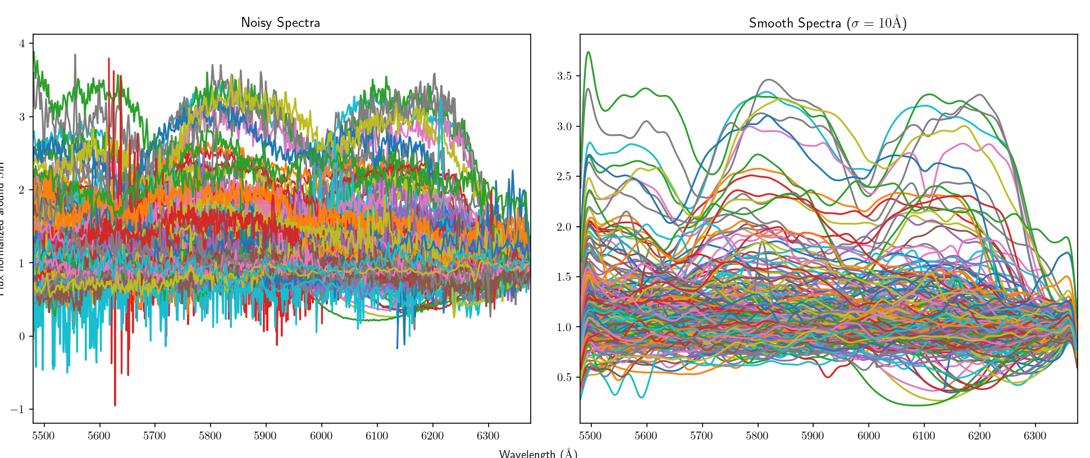
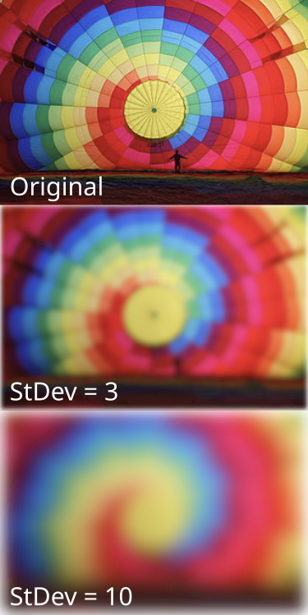
Preprocessing
Smooth data using gaussian filter
gaussian is a low-pass filter
In effect, removes much of the noise
Credit: IkamusumeFan (Wikipedia)

Slide 9
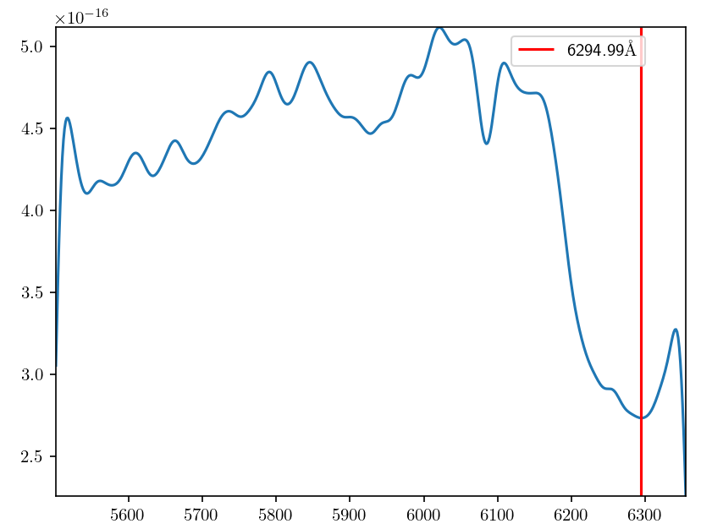
Calculating Velocity
Took simple approach
Assume given redshift is correct
Find relative minima of the smoothed spectrum
Due to the process of a supernova, the first minima below the Si II emission line should be the equivalent Si II absorption line

Slide 10
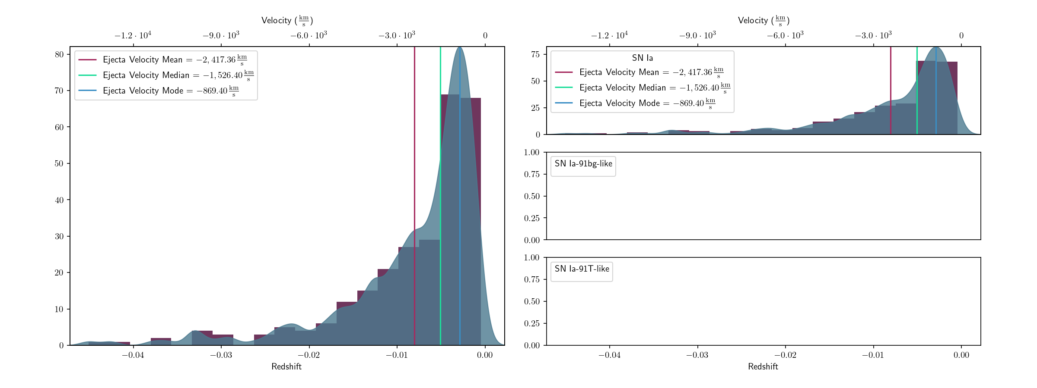
KDE/Histogram

Slide 11
Probability Density

